Slide 1
Computer Networks
by
Surendra Kr.Keshari
Assistant Professor
KIET Group of Institutions

Slide 2
Introduction of Data Communication and Computer Networks: Goals & Applications of Networks

Slide 3
Data Communications
For communication of information and messages we use telephone and postal communication systems .
Data and Information from one computer system can be transmitted to other systems across geographical areas in this methods it include electrical signals carried along a conductor, optical signals along an optical fibers and electromagnetic areas.
Data communications are the exchange of data between two devices via some form of transmission medium such as a wire cable.

Slide 4

Basic Elements of a Communication System

Slide 5

Data flow

Slide 6
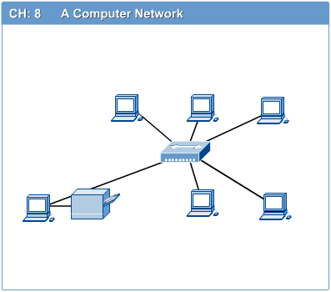
Networks
  A network is a set of devices (often referred to as nodes) connected by communication links. A node can be a computer, printer, or any other device capable of sending and/or receiving data generated by other nodes on the network.
  Computer network connects two or more autonomous computers.
  The computers can be geographically located anywhere.

Slide 7
Computer Networks
  A computer network is an interconnection of various computer systems located at different places
  Two or more computers are linked together with a medium and data communication devices for the purpose of communicating data and sharing resources
  The computer that provides resources to other computers on a network is known as server.
  Individual computers in the network, which access shared network resources, are known as nodes.

Slide 8

Types of connections

Slide 9
Uses of Computer Networks
Business Applications
Home Applications
Mobile Users
Social Issues

Slide 10
Goals and Applications of Networks
Resource sharing: This is the main aim of a computer network. It means to make all programs peripherals and data available to any one computer on the network to all other computers in the network without regard to the physical locations of them. Thus user at large distances can share the resources or can see data of a computer in the same way that a local user uses them. Another aspect of resource sharing is load sharing. That is if required, a job can be performed using various computers in network by portioning it which reduces time consumption and load both for a particular computer.

Slide 11
Goals and Applications of Networks
  High reliability:- A second goal is to provide high reliability by having alternative sources of supply. For example, all files could be replicated on two or three machines, so if one of them is Unavailable, the other copies could be available.
  Cost Reduction:- Another goal of networking is reduction of cost. Resource sharing automatically reduces cost and hence money can be saved.
  Communication Medium:- Computer networks provide a powerful communication medium. A file that was updated/modified on a network can be seen by the other users on the network immediately.

Slide 12
Goals and Applications of Networks
  Improve Performance:- Another closely related goal is to increase the systems performance. The performance of a computer can be improved by adding one or more processors to it as the work load on it grows.
  For example if the system is full instead of replacing it buy a larger one at large expansive it is better to add more processors to it on less cost and less disruption to the user.

Slide 13
Applications of Networks
  Marketing , sales, Financial services
  Manufacturing. CAD, CAM etc.
  Information services
  Cellular telephone
  Cable television
  Teleconferencing
  EDI
  E-mail , WWW etc.

Slide 14
References
  Behrouz Forouzan, “Data Communication and Networking”, McGraw Hill
  Andrew Tanenbaum “Computer Networks”, Prentice Hall.
  William Stallings, “Data and Computer Communication”, Pearson.
  Kurose and Ross, “Computer Networking- A Top-Down Approach”, Pearson.
  Peterson and Davie, “Computer Networks: A Systems Approach”, Morgan Kaufmann
  W. A. Shay, “Understanding Communications and Networks”, Cengage Learning.
  D. Comer, “Computer Networks and Internets”, Pearson.
  Behrouz Forouzan, “TCP/IP Protocol Suite”, McGraw Hill.

Slide 15
Thank
You

